Slide 1
CENTRE for INDUSTRY
EDUCATION COLLABORATION
Sustainable ingredients:
Who has the cleanest classroom?

Slide 2
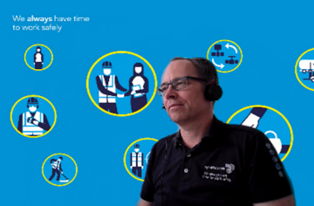
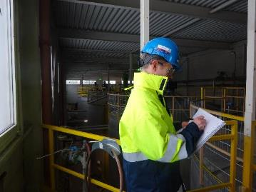
STEM Careers
This is Guy. He studied to become an engineer at university and his first job was helping factories improve processes to be safer and use less fuel, water and materials.
He has had different jobs linked to safety and sustainability over 30 years working in 4 different countries and visiting many others, helping sites find better ways of working.
Guy often talks to people using his computer, which helps save fuel and waste by only travelling when he has to.
Notes:
Image: - Copied image provided in PowerPoint, original JPG requested

Slide 3

www.ciec.org.uk

